Slide 1
Radnor House Sevenoaks Spring FUNdraising & House Competitions
Act Your Age-athon! and House Music & Singing

Slide 2
Act Your Age-athon!
Can you take your age and do something good with it?
Ask your friends and family to consider sponsoring you.
Walk your age in km or miles - or walk with your family for a combined age (walk this in a week, or month)
Wear that many layers for a day in return for a donation
Do that many keep uppies
Silence for that many hours
Empty the dishwasher that many times
Just donate your age
Read that many pages of a book for that many days
Stay off your devices for that many hours
Get sponsored for a skip – take your age, double it, triple it and skip that many times. You could film it and share with friends and family . Time your skips - challenge someone to do the same and the loser does a forfeit! Or put up a small prize for the fastest.. (training needed!)

Slide 3
What to do with your funds raised…
Make your donation to your house here:
https://www.radnor-sevenoaks.org/friends/donate-to-our-charities-here
Let your house, school and friends@radnor-sevenoaks.org know that you’ve done it!

Slide 4
House Singing & Music- ‘Together’
With the country entering our 3rd Lockdown and with everyone learning remotely once again, we’ve decided to press on with this House Competition… virtually. Whether you are a great vocalist or you play a musical instrument, this is a chance for you to display your talents to your House and the rest of the year/ school.
All you have to do is perform a song or a piece of music with the theme of ‘Together’ (I’ve kept the theme very open).

Slide 5
House Singing & Music- ‘Together’
Your song or piece can be up to 5 minutes long and should be submitted in the form of a video (and audio) in your House Team.
Please submit the videos by February 1st
Your song or musical piece can be a cover or an original.
If you wish to play your music accompanied or sing as a duet with someone in your ‘bubble,’ this would be fine.

Slide 6
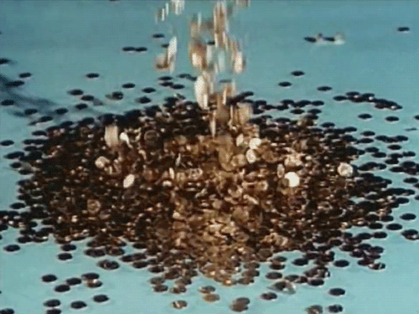
How to donate…
Newton
https://uk.virginmoneygiving.com/charity-web/charity/displayCharityCampaignPage.action?charityCampaignUrl=RH7NEWTONFUNdraising20/21
Churchill
https://uk.virginmoneygiving.com/charity-web/charity/displayCharityCampaignPage.action?charityCampaignUrl=RH7CHURCHILLFUNdraising20/21
Nightingale
https://uk.virginmoneygiving.com/charity-web/charity/displayCharityCampaignPage.action?charityCampaignUrl=RH7NIGHTINGALEFUNdraising20/21
Pankhurst
https://uk.virginmoneygiving.com/charity-web/charity/displayCharityCampaignPage.action?charityCampaignUrl=RH7PANKHURSTFUNdraising20/21

Slide 7
Where to send the love…
West Kent Mind, Glen Dunlop House 32-34 St. Johns Road Sevenoaks Wellbeing Centre, Sevenoaks TN13 3LW
Foal Farm Animal Rescue Centre Jail Lane, Biggin Hill TN16 3AX
Bradbourne Riding & Training Centre, Bradbourne Vale Road, Sevenoaks TN13 3DH
Leonard Cheshire Disability, Chipstead Lake Chevening Road, Sevenoaks TN13 2SD

