Slide 1
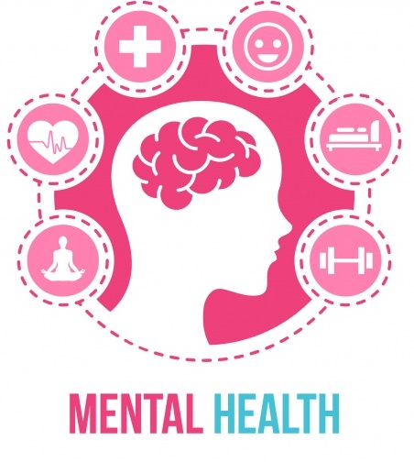
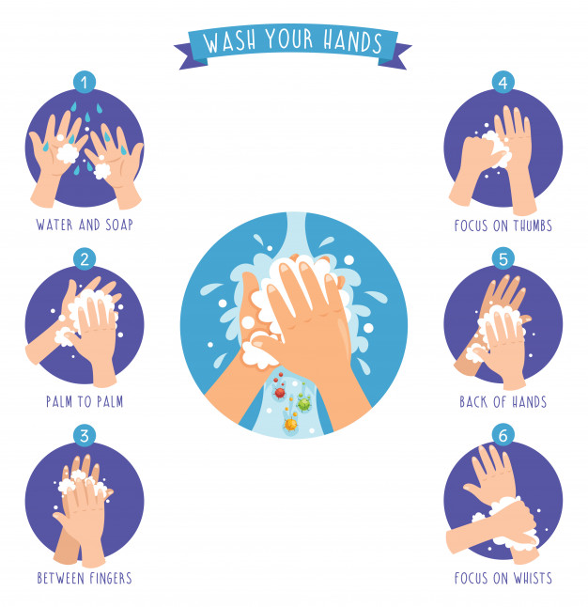
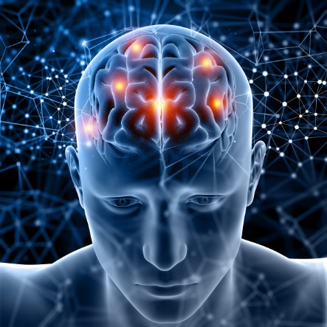
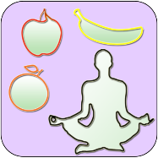
What is mental health?
“The state in which your mind is from a psychological wellbeing perspective”
Mental Health vs Mental Illness
Mental Health is a person’s condition with regard to their psychological
and emotional well-being
Mental Illness is a clinically diagnosable illness affecting how a person thinks and feels, behaves and interacts with other people
Good mental health indicates a balanced, stable mind where there aren’t any prolonged negative states, no long-term emotional imbalances or dysfunction, you can appropriately express how you feel or manage your emotions or seek the appropriate help where needed.
Poor mental health indicates a feeling of not being in control with your emotions, long term negative emotions, difficulty expressing yourself emotionally, feeling alone or isolated, extremes of emotional states such as rage, suicidal thoughts, feeling disconnected. Mental health can affect your physical health.
Mental health is something that can affect anyone, our environment and bodies are changing constantly and sometimes it can be stressful. It’s important to find a trusted adult you can confide in during the difficult times and celebrate the stress-free moments.
Notes:
This is not an exhaustive list but just some suggestions that may be helpful!
Please keep up to date with government guidance and take care of yourselves

Slide 2
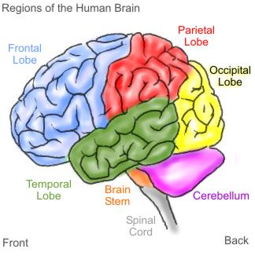
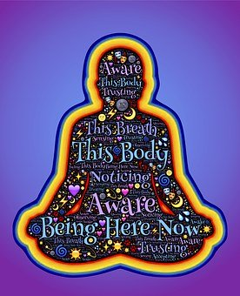
What kinds of people does mental health impact?
“Everybody can be affected by mental health imbalances. The brain and the body has a lot of information they are processing and sometimes it can be a little too much and we need a little outside help or advice. It’s nothing to worry about or be ashamed. This is part of the human experience. It allows us to connect with others, learn, grow and help someone else in the future when they are in a similar situation.”
Choosing what is correct for you to feel good and maintain overall good health, is just as important as your physical health. The body and the brain are one and both play equal roles in keeping us alive, healthy and well. One cannot do the job without the other. The body and the brain talk to each other via the nervous system and endocrine system (hormones), they are both always receiving information from the other (like a computer and a server) and that information is always trying to keep you, safe, happy and healthy
BRAIN
BODY
Notes:
This is not an exhaustive list but just some suggestions that may be helpful!
Please keep up to date with government guidance and take care of yourselves

